Slide 1
Dream Job of Software Development
Matt Wilkins

Slide 2
Type of Job I’m Seeking
Job in Software Development
Software Development involves:
Computer program creativity
Device application development
Task making on them
System underlying development
Network controlling
Device running

Slide 3
Some Duties and Responsibilities
Meeting needs of users with software
Designing of applications and systems
Flowchart creations for software code
Development process leader
Doing program improvements and fixes

Slide 4
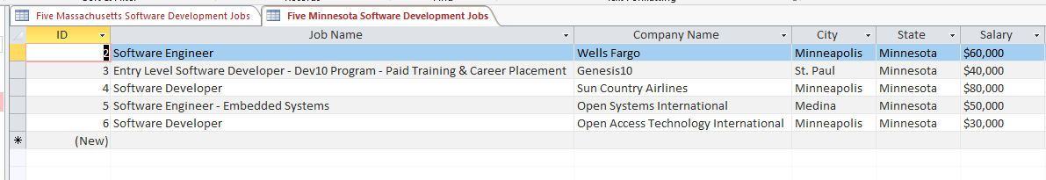
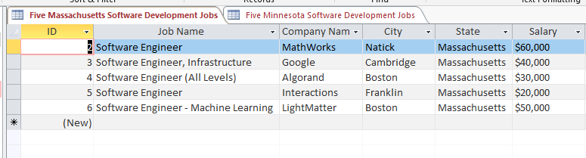
Potential Jobs

Slide 5
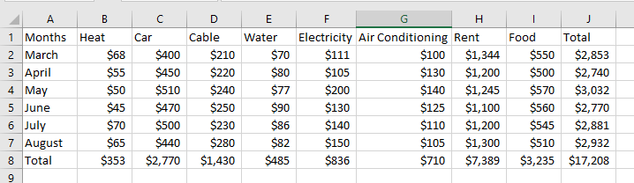
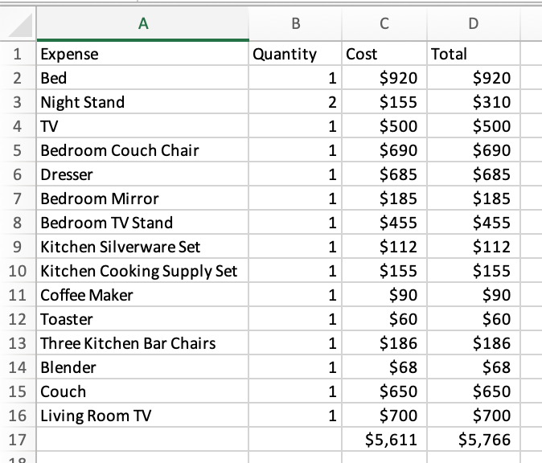
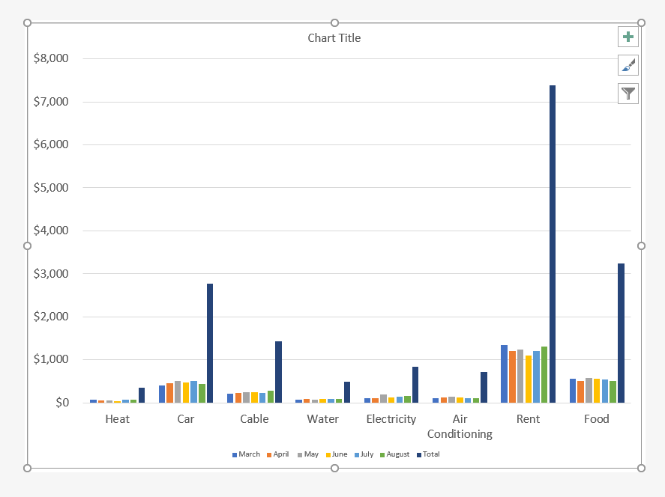
Expenses

Slide 6
One of the Jobs I Found
Software Engineer - Embedded Systems
Open Systems International in Medina, MN
Job position description of some responsibilities
Requirement analyzation and design development
Detailed and also functional
Procedure and plan creating
Test performance
Product releasing

Slide 7
Another Job
Software Developer
Open Access Technology International in Minneapolis, MN
Job position description of some responsibilities
Software design along with requirement specifications
Code writing
Quality and efficient code writing
Software design coding standards

Slide 8
Conclusion
Many jobs available
Many field options
Strong chances
Pays a lot
Possibly switching college majors

Slide 9
Sources
https://www.bls.gov/ooh/computer-and-information-technology/mobile/software-developers.htm#:~:text=Software%20developers%20typically%20do%20the,the%20pieces%20will%20work%20together
https://www.linkedin.com/jobs/view/software-engineer-embedded-systems-at-open-systems-international-2270271292?utm_campaign=google_jobs_apply&utm_source=google_jobs_apply&utm_medium=organic
https://www.glassdoor.com/job-listing/software-developer-open-access-technology-international-JV_IC1142551_KO0,18_KE19,55.htm?jl=3495985935&utm_campaign=google_jobs_apply&utm_source=google_jobs_apply&utm_medium=organic

